Slide 1
GCBASIC
PIC18FxxQ24
Part 20 - Summary

Slide 2
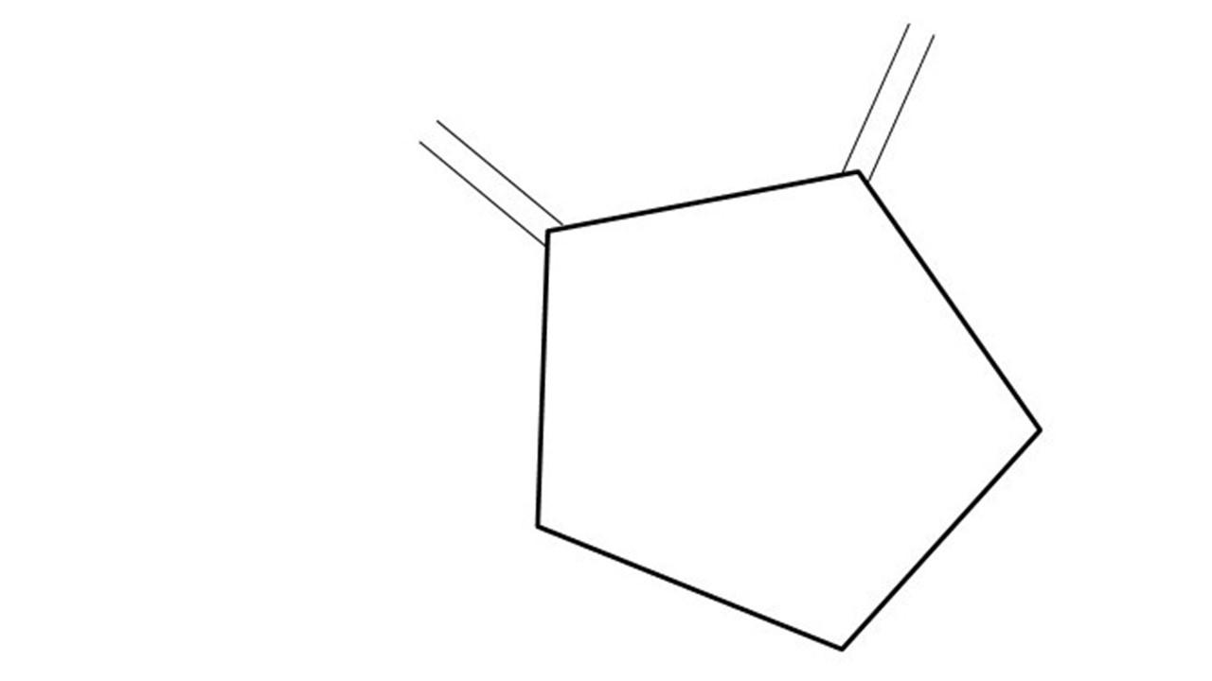
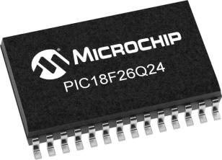
GCBASIC
PIC18FxxQ24
Part 20 - Summary

Slide 3
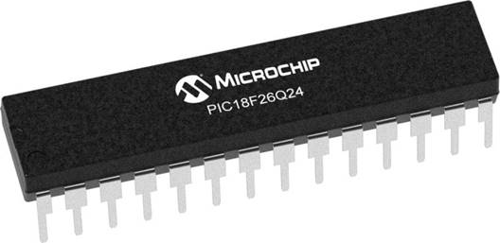
GCBASIC
Like and subscribe!

Slide 4
PIC18FxxQ24
PIC18-Q24 is a high performance PIC18
Digital and Analog peripherals
10-bit ADC
Multiple communication interfaces
Serial, I2C and SPI
PWM – CCP/PWM and 16Bit
Configurable Logic Cells
Multi voltage domains
The PIC18xxQ24 offers 28, 40 and 48-pin products in small footprint packages to support customers in a wide variety of applications.

Slide 5
Videos...
Install the hardware and make the board work – three LED programs
Make four LEDs flash in a sequence
Set the LEDs to represent the value of ADC
Sequence the LEDs with a delay using the value of ADC
Using an input to set the state of the LEDs
Using the reset switch
Using the switch, ADC – make the LEDs flash in a sequence with reverse
Using the serial to display values
Using the timer0 overflow, 8bit timer, 16bit timer to flash the LEDs
Using EEProm – showing values on the serial terminal, and more constants insights
Using I2C with serial to discover I2C devices
Using an I2C GCLD display
Using a SPI GCLD display
Using PWM, 7 ways, to dim the LEDS
Using an external interrupt to control an LED
Using storage within the chip – Progmem, SAF memory, EEPROM and DATA blocks
Using CLC
The GCBASIC tool chain
Assembly , alternatives assemblers and MPLAB-X
Summary

Slide 6
GCBASIC Compiler
GCBASIC is an Open Source compiler for PIC, AVR and LGT microcontrollers
GCBASIC now supports the 18FxxQ20 chip family
GCBASIC is a cross platform with common code translation
GCBASIC Compiler

Slide 7
The core compiler
High Level Language
Reports:
TXT and HTML
Source Code
GCBASIC Compiler
GCBASIC Compiler
Preprocessor
Code Translator
Assembler
Linker
Assembly Language
ASM file
Absolute Machine Code
HEX file
Libraries
8 bit PIC, AVR, AVR-DX and LGT

Slide 8
Compiler options
High Level Language
Reports:
TXT and HTML
Source Code
PIC-AS, MPASM,
MPLAB-IDE,
GPASM, AVRASM2
GCBASIC Compiler
GCBASIC Compiler
Preprocessor
Code Translator
Assembler
Linker
Assembly Language
file
Absolute Machine Code
HEX file
Libraries
8 bit PIC, AVR, AVR-DX and LGT

Slide 9
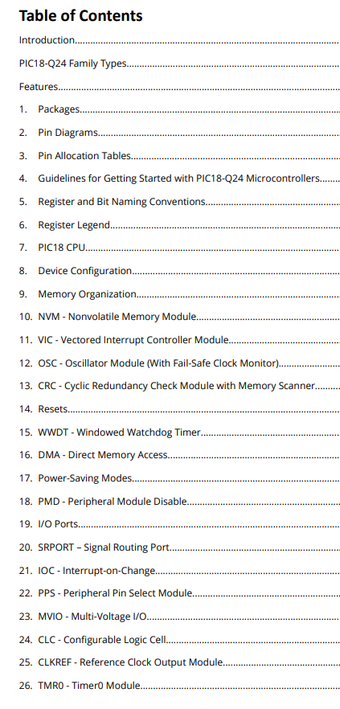
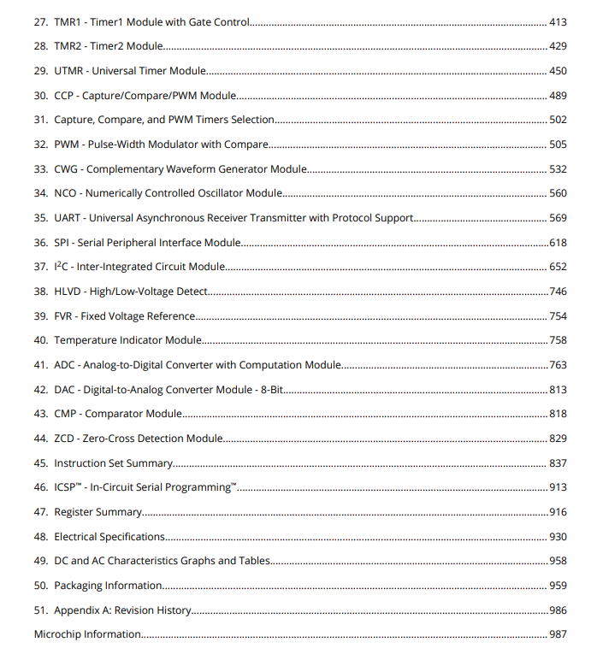
Capability Review
Supported
Supported - see video
Supported - see other demos
Not supported

Slide 10
Resources
Tutorial source code
https://github.com/GreatCowBASIC/Demonstration_Sources/tree/main/Vendor_Boards/Great_Cow_Basic_Demo_Board/18Fx6q24_ChipRange_Demonstrations
Tutorial presentations
https://github.com/GreatCowBASIC/Demonstration_Sources/tree/main/Vendor_Boards/Great_Cow_Basic_Demo_Board/18Fx6q24_ChipRange_Demonstrations/tutorials

Slide 11
Summary
GCBASIC supports the PIC18-Q24
Digital and Analog peripherals
12-bit ADC
Multiple communication interfaces
Serial, I2C, SPI
PWM – CCP/PWM and 16Bit
Configurable Logic Cells
GCBASIC supports multiple 32/64 bit operating systems and integrates with MPLAB-X

Slide 12
GCBASIC
PIC18FxxQ24
Part 20 - Summary

